Slide 1

Cooperative magnetic vector inversion with $l_{p}$-norm regularization
MSc. Thesis Defense
Dominique Fournier

Slide 2
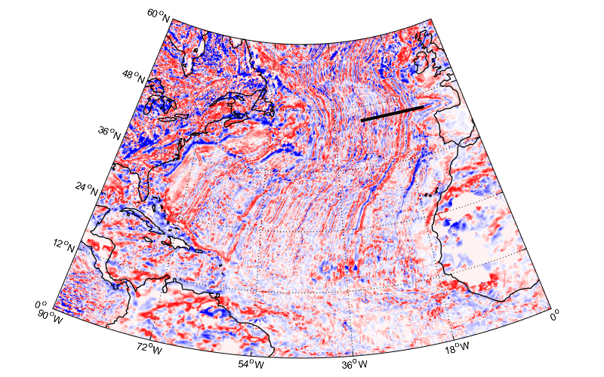
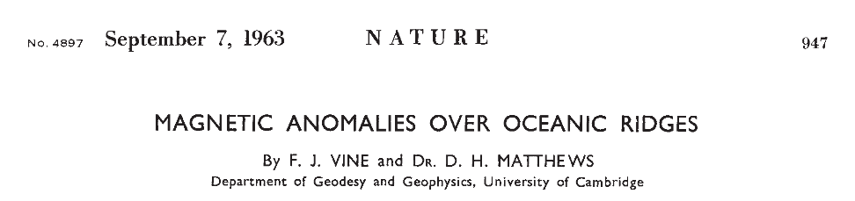
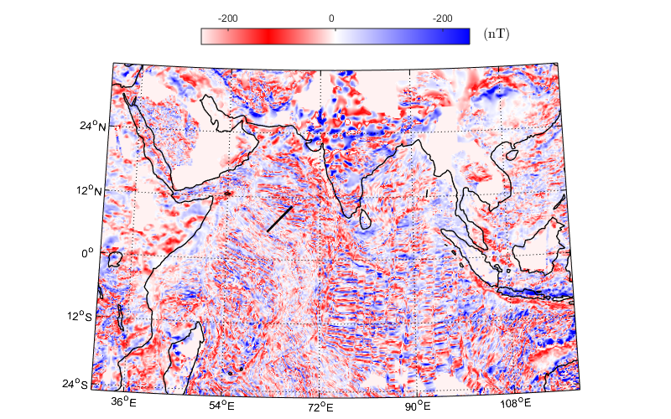
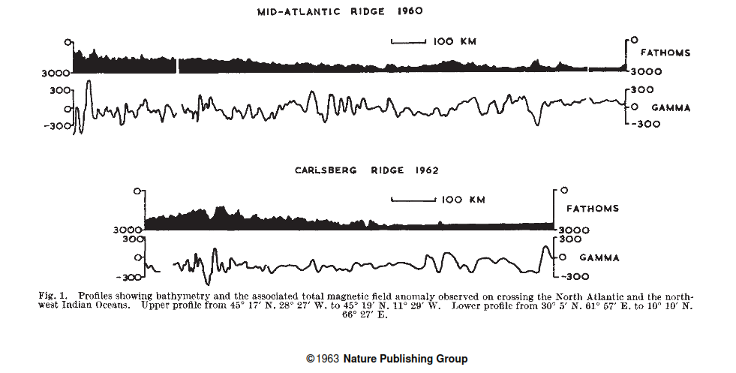
Magnetism in geoscience
A long history…

Slide 3
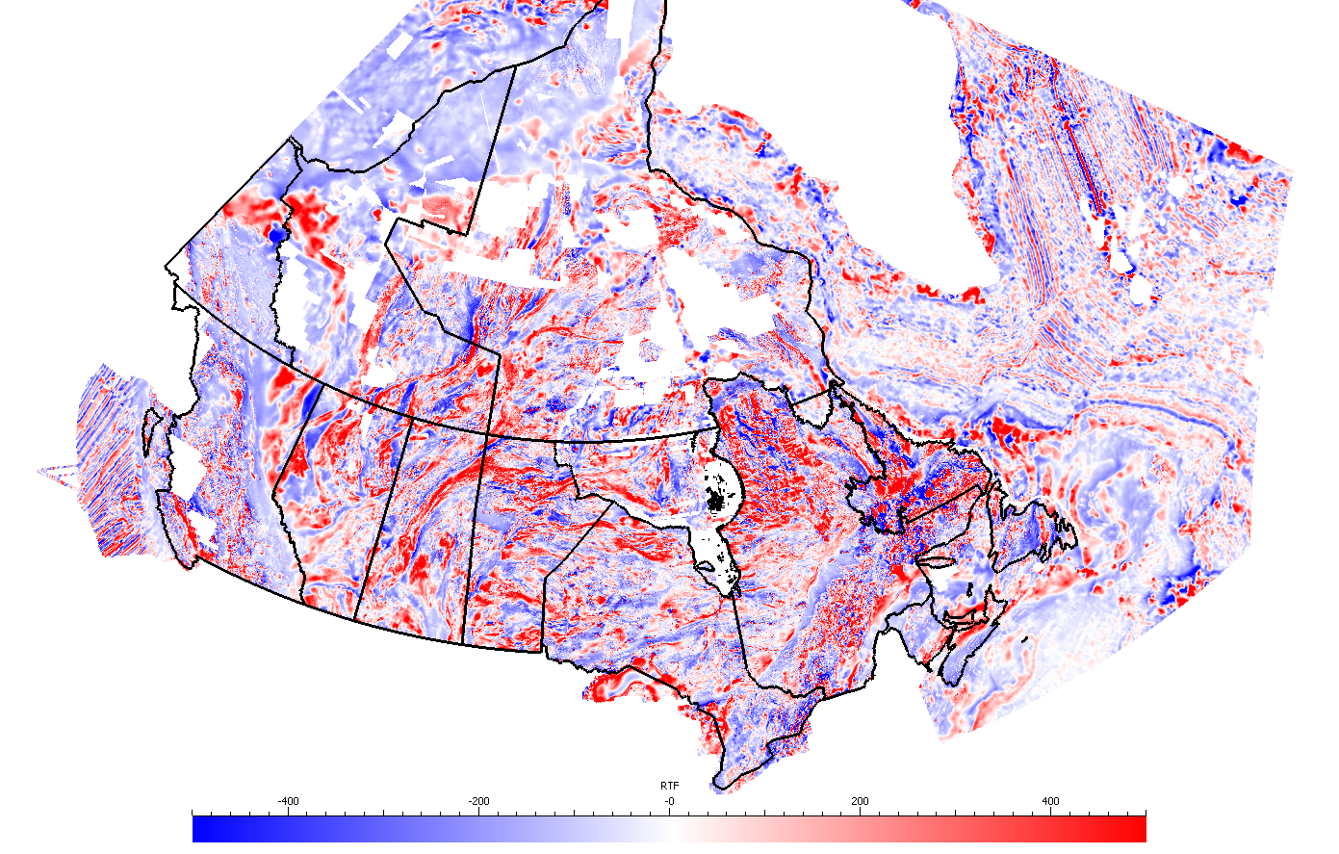
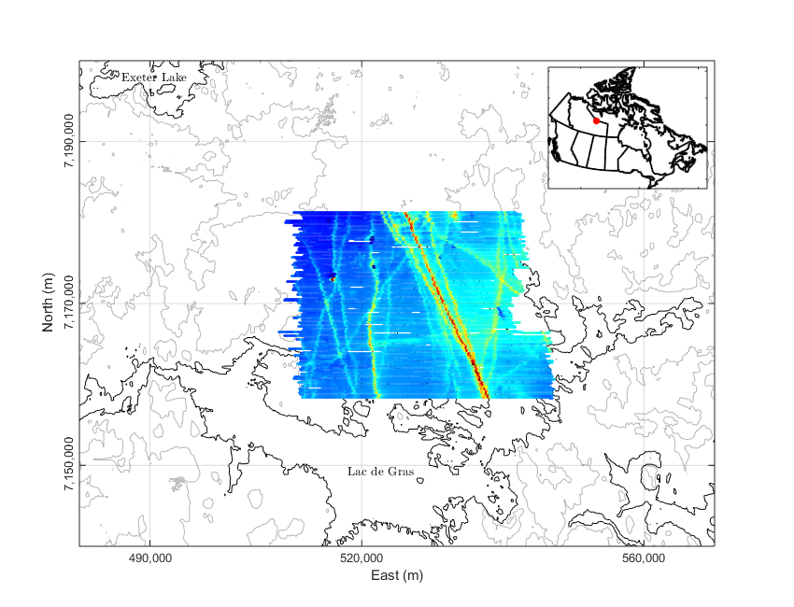
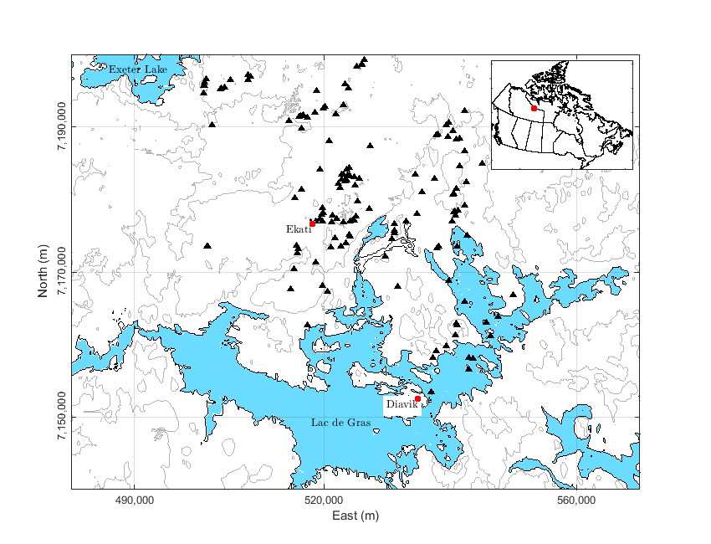
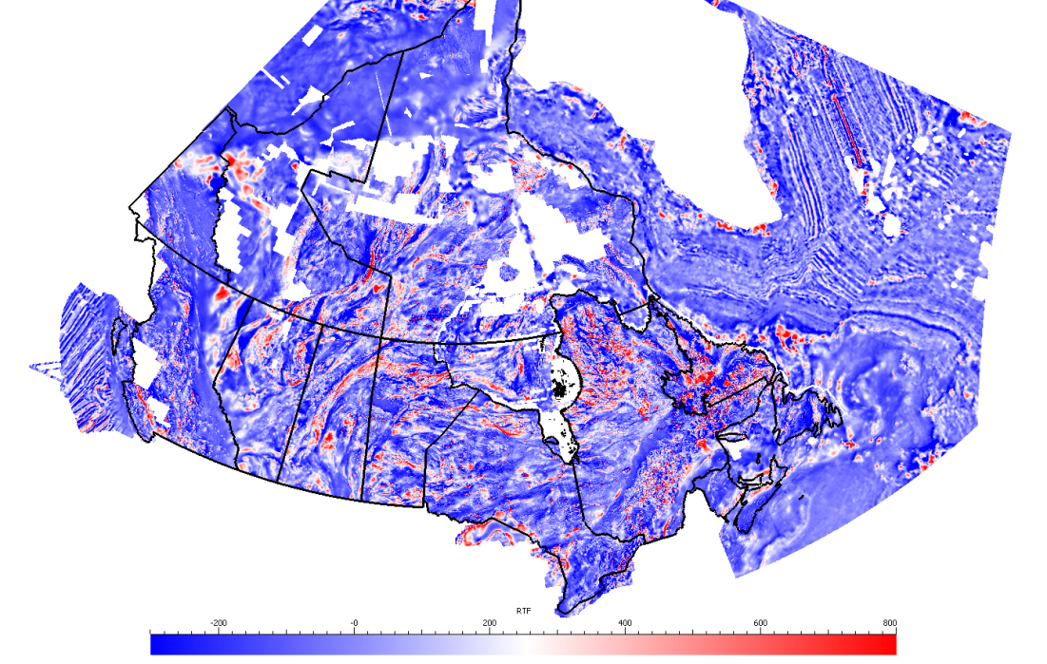
Magnetism in geoscience
TMA
… at all scales.

Slide 4
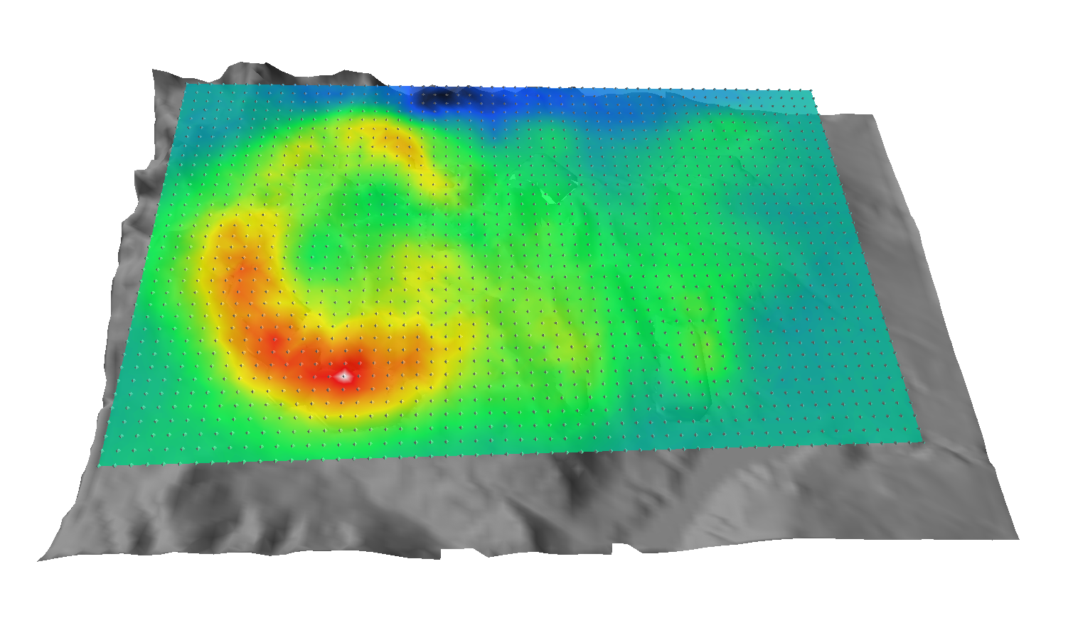
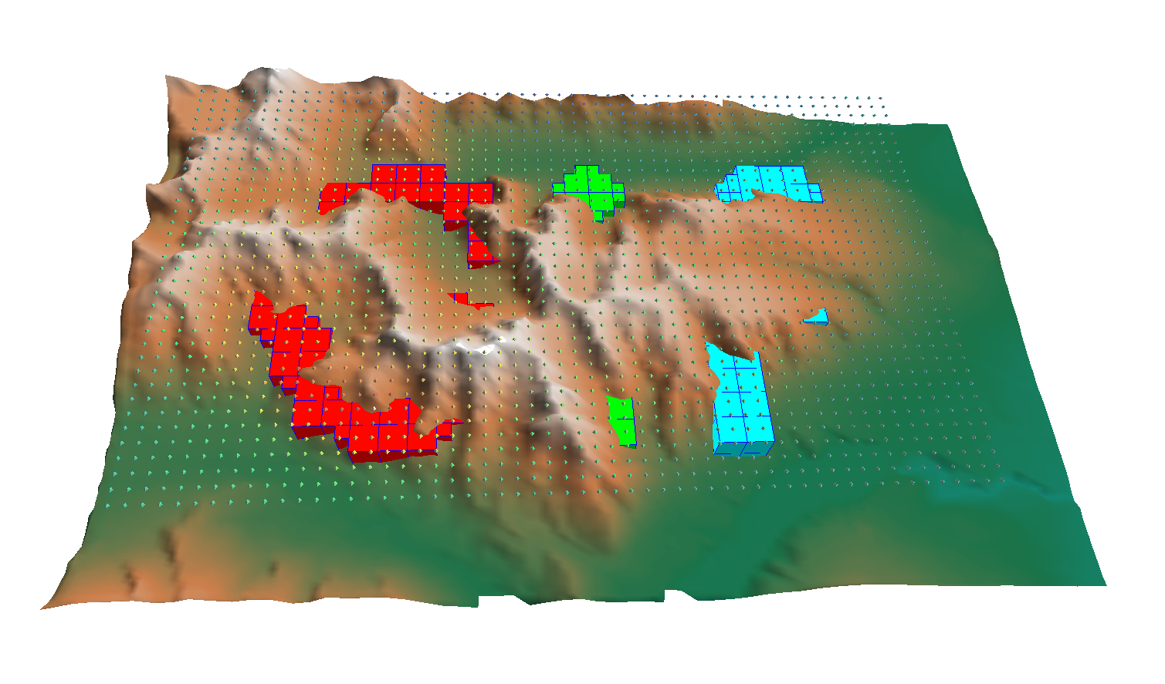
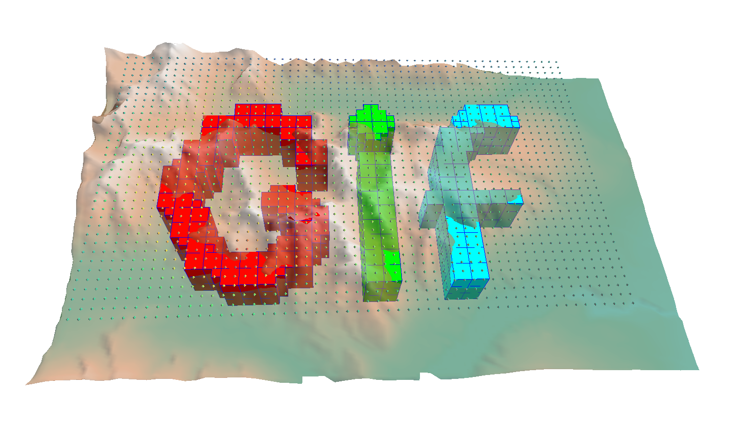
Magnetism in geoscience
Imaging the sub-surface:

Slide 5
Outline
Forward problem
Inverse problem
Susceptibility Inversion
Amplitude Inversion
Magnetic Vector Inversion
Sparse regularization
Cooperative Magnetic Inversion
Case Study

Slide 6
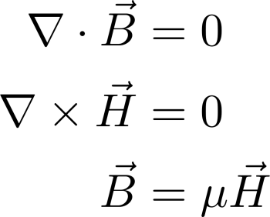
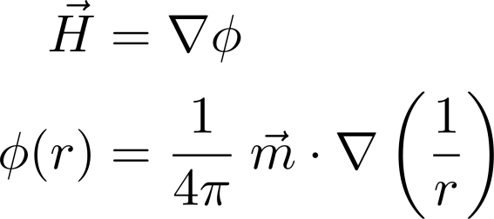
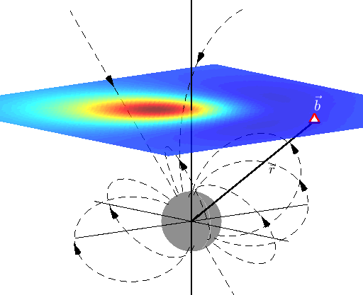
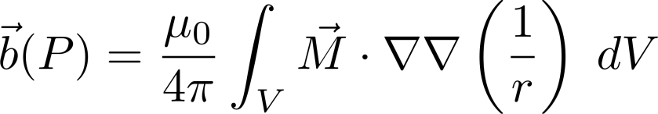

Forward Problem
Maxwell’s equations – current free, static field
$$\vec{M}$$

Slide 7
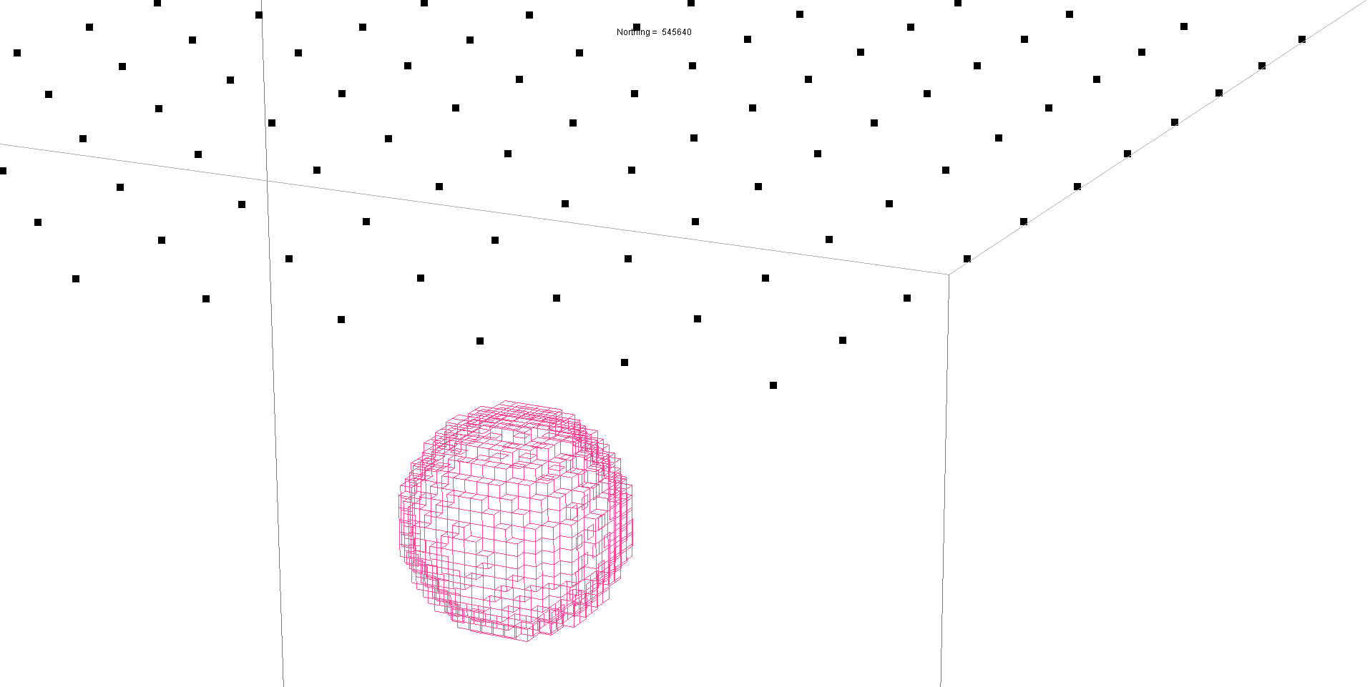
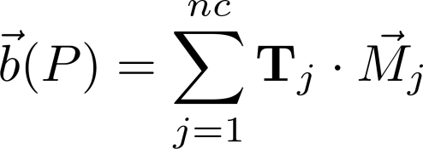
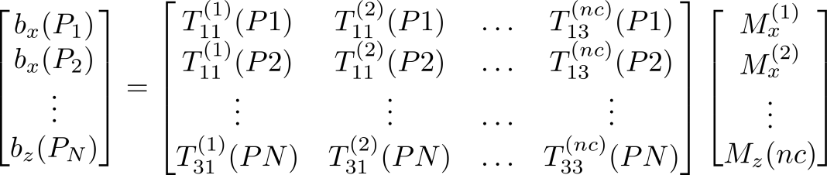
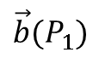
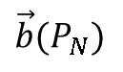
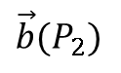
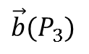
Forward Problem
Integral formulation for prism
$$\vec{b}(P_{3})$$
$$\vec{b}(P_{N})$$
$$\vec{b}(P_{2})$$
$$\vec{b}(P_{1})$$
3*nc
..
3*nd

Slide 8
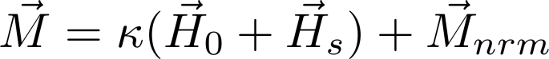
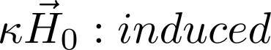
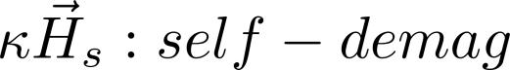
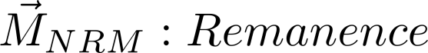
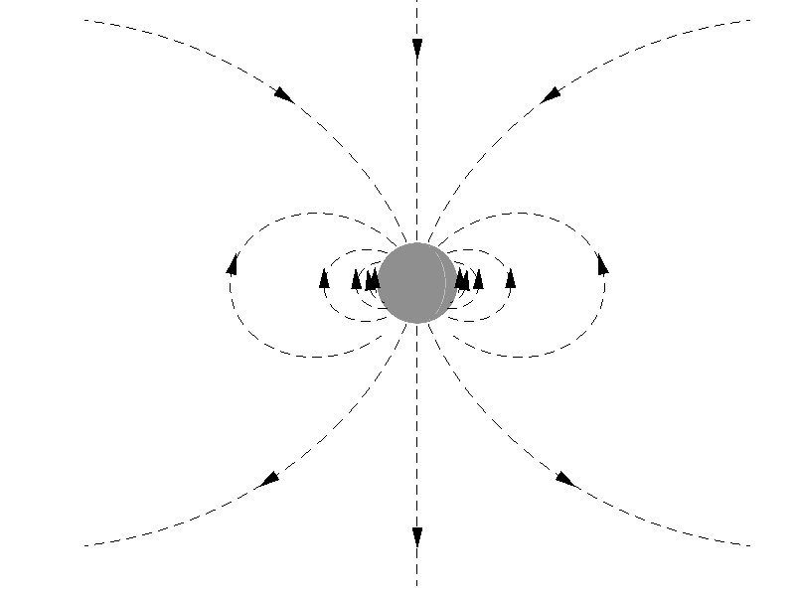


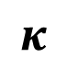
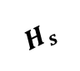
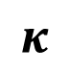
Magnetization
Magnetization
$$H_{0}$$
$$κ$$
$${\vec{M}}_{nrm}$$
$$H_{s}$$
$$κ$$

Slide 9
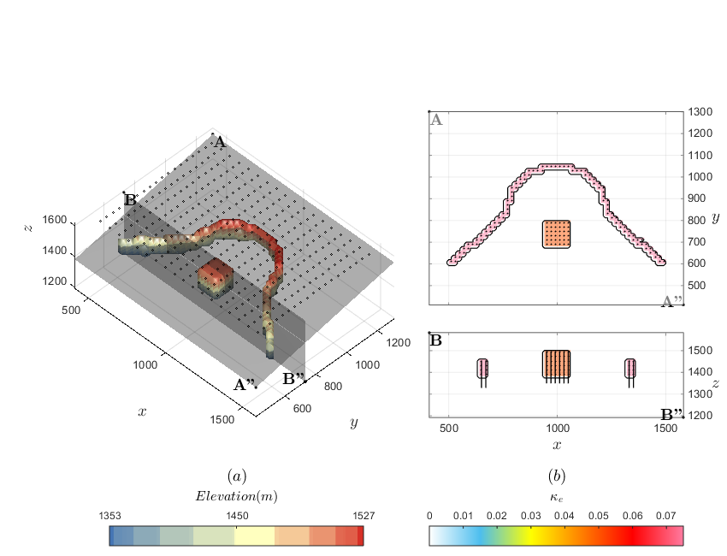
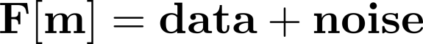
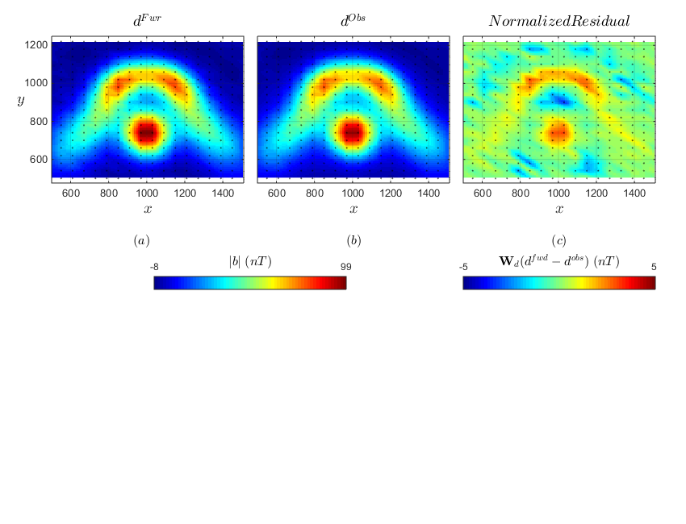
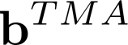
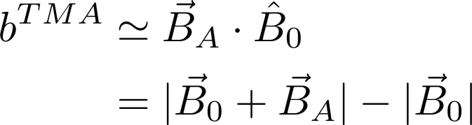

Forward Problem
Synthetic model
Forward
$$H_{0}$$

Slide 10
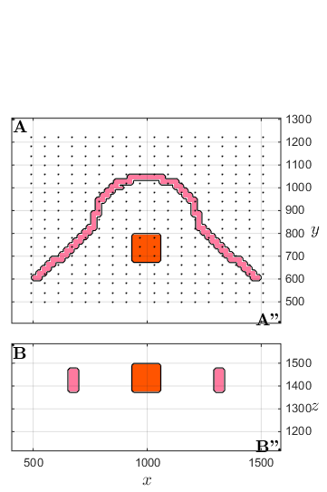
Inverse Problem
A harder problem…
Inversion
?
?

Slide 11
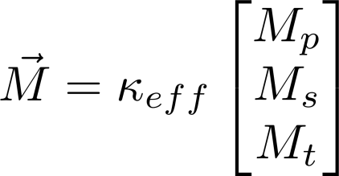
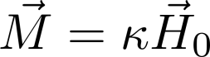
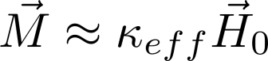
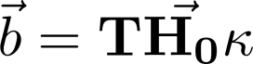
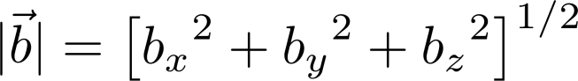
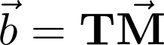
Thesis in a nutshell
All induced
Amplitude data
No assumptions
UBC-MAG3D
(Li & Oldenburg 1996)
Amplitude Inversion
(Li & Shearer 2005)
Magnetic Vector Inversion
(Lelièvre & Oldenburg 2009)
1
2
3

Slide 12
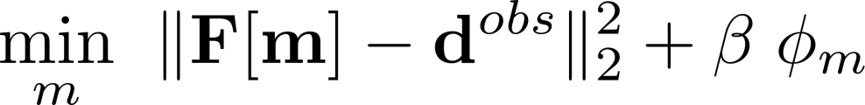
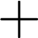
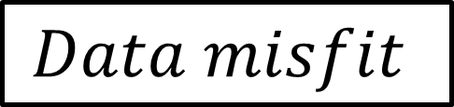
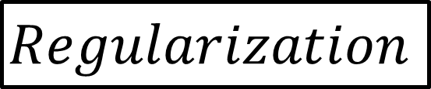
Thesis in a nutshell
UBC-MAG3D
(Li & Oldenburg 1996)
Amplitude Inversion
(Li & Shearer 2005)
Magnetic Vector Inversion
(Lelièvre & Oldenburg 2009)
1
2
3
$$Data misfit$$
$$Regularization$$
Cooperative Magnetic Inversion

Slide 13
Susceptibility Inversion
UBC-MAG3D
(Li & Oldenburg 1996)
Amplitude Inversion
(Li & Shearer 2005)
Magnetic Vector Inversion
(Lelièvre & Oldenburg 2009)
1
2
3
$$Data misfit$$
$$Regularization$$

Slide 14
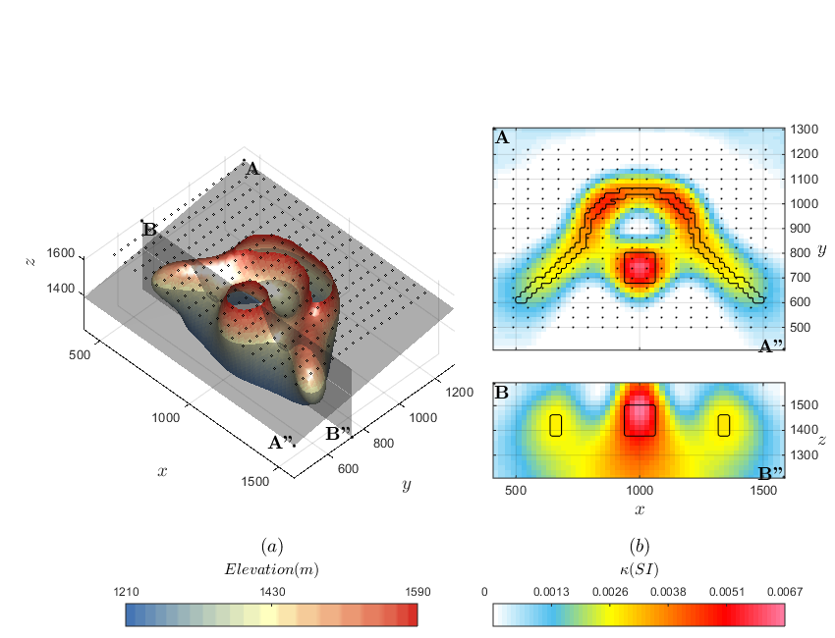
Susceptibility Inversion
1
Inversion
?
?

Slide 15
Susceptibility Inversion
1
Anomaly at the right location
Reproduce the data fairly well
Smooth model
Easy Problem

Slide 16
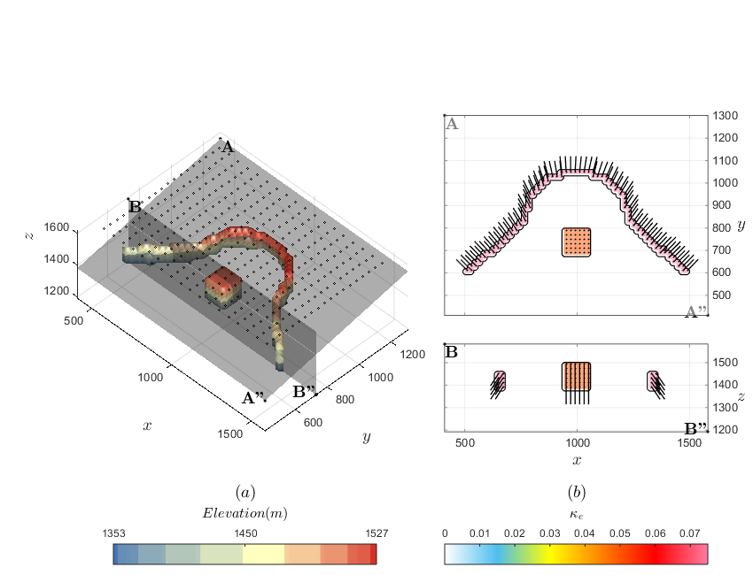
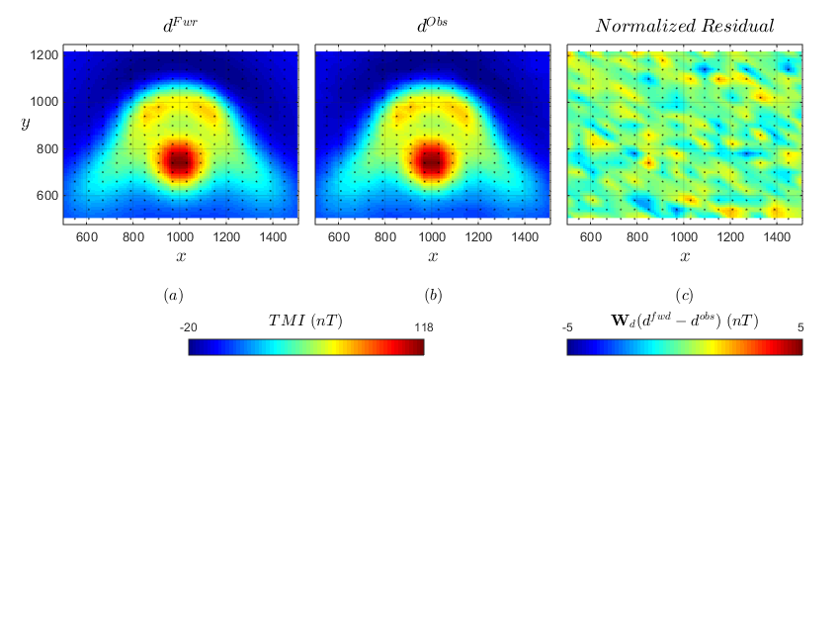
Susceptibility Inversion with Remanence
1
Forward

Slide 17
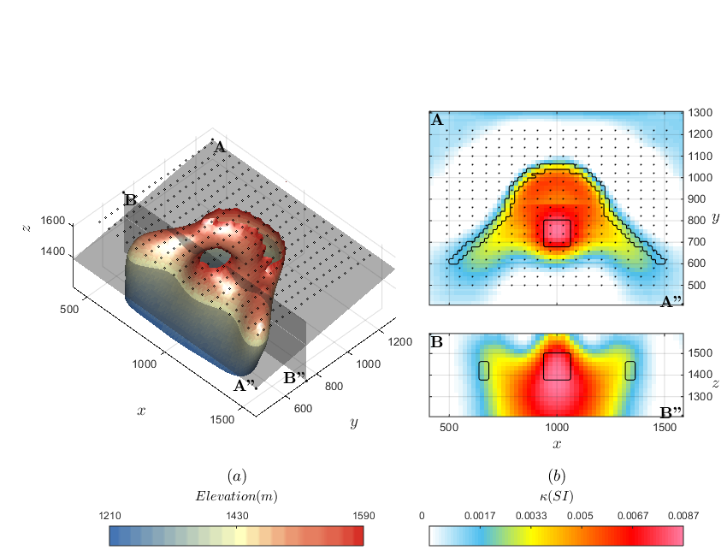

Susceptibility Inversion with Remanence
1
Inversion
?
?

Slide 18
Susceptibility Inversion with Remanence
1
Potential issues if strong remanent component
Susceptibility model is distorted
Can’t reproduce the negative anomaly

Slide 19
Magnetic Amplitude
UBC-MAG3D
(Li & Oldenburg 1996)
Amplitude Inversion
(Li & Shearer 2005)
Magnetic Vector Inversion
(Lelièvre & Oldenburg 2009)
1
2
3

Slide 20






Magnetic Amplitude
2
Amplitude Inversion
(Li & Shearer 2005)

Slide 21




Magnetic Amplitude
Generate component data from equivalent source layer
1
Equivalent
Source

Slide 22


Magnetic Amplitude
2
Inversion

Slide 23
Magnetic Amplitude
2
Non-linear problem
Good approximation for the geometry of magnetic objects
Tendency to stretch anomalies at depth – requires more research

Slide 24
Magnetic Vector Inversion
UBC-MAG3D
(Li & Oldenburg 1996)
Amplitude Inversion
(Li & Shearer 2005)
Magnetic Vector Inversion
(Lelièvre & Oldenburg 2009)
1
2
3

Slide 25






Magnetic Vector Inversion
3
(Lelièvre & Oldenburg 2009)
$$H_{0}$$
$$\hat{t}$$
$$\hat{s}$$
$$\hat{p}$$

Slide 26


Magnetic Amplitude
3
Inversion

Slide 27
Current State of Research
Susceptibility Inversion
Amplitude Inversion
Magnetic Vector Inversion
1
2
3

Slide 28
Magnetic Amplitude
Susceptibility inversion is cheap, but strongly dependent on magnetization direction
Amplitude inversion is more robust, but generally smooth
Magnetic vector inversion could potentially give the full mag vector, but largely underdetermined.
All too smooth for easy interpretation !

Slide 29


Compact norm regularization
Our usual objective function
Regularization

Slide 30


Compact norm regularization
Approximate other norms:

Slide 31



Compact norm regularization
Iterative Re-weighted Least Squares (IRLS)
where

Slide 32


Compact norm regularization
Main contributions: Scaled-IRLS
Strategy to determine ε (Effective zero)
$φ_{m}$ scaling: $γ^{(k)}$ (Smooth transition)
Norm scaling: $\hat{R}=ηR$ (Equal contribution)

Slide 33

Compact norm regularization
Synthetic:

Slide 34


Compact norm regularization
Synthetic:

Slide 35


Compact norm regularization
Synthetic:

Slide 36
Compact norm regularization

Slide 37

Cooperative Magnetic Inversion (CMI)

Slide 38




Cooperative Magnetic Inversion (CMI)
Equivalent Source
Amplitude Inversion
Magnetic Vector Inversion
1
2
3

Slide 39

Case Study
Ekati Property - Northwest Territories

Slide 40

Case Study
Data preparation

Slide 41

Case Study
Tiled Inversion

Slide 42




Case Study
$$\sqrt{{\hat{s}}^{2}+{\hat{t}}^{2}}$$
Recovered model
$$\hat{p}(+)$$
$$\hat{p}(−)$$

Slide 43

Case Study
Recovered model

Slide 44


Case Study
Misery Pipe
Property owned by BHP Billiton
Pre-stripping under way
Production expected to start in 2016

Slide 45

Case Study
Recovered model
Local anomaly showing reversely magnetized body
Removal of the regional field to enhance the target

Slide 46



Misery Pipe
Magnetic Inversion
Geology from drilling
Inverted model
Borrowed from Nowicki et al. (2004)

Slide 47

Conclusion
Achieved goals:
Cooperative Magnetic Inversion code
Robust $l_{p}$-norm regularization
Large scale inversion with tiling procedure
Future Research
Reduce the non-uniqueness
Combined EM and magnetic data
Include Koenigsberger ratio information
MVI in spherical coordinates
Adaptive local meshing inversion

Slide 48
Thank you!
Dr. Doug Oldenburg
Dr. Kristofer Davis
Friends @ UBC-GIF
Staff @ Mira Geoscience
Dr. Randy Enkin @ GSC
Brooke Clements @ Peregrine Diamonds
Chantelle Bellrichard @ home

Slide 49
Backup Slides

Slide 50


Compact norm regularization
Case Study: Tli Kwi Cho kimberlite deposit

Slide 51

Compact norm regularization
Lp-norms:

Slide 52
Compact norm regularization
Mix-norm solution

Slide 53
Case Study
Recovered model
Property owned by BHP Billiton
Pre-stripping under way
Production expected to start in 2016
Borrowed from Nowicki et al. (2004)

Slide 54

Norm gradient
Normalized by maximum

Slide 55

Gradient Scaling

Slide 56

Regularized Least-Squares
l2 vs l1 vs l0

Slide 57

Regularized Least-Squares
l2 vs l1 vs l0

Slide 58

Compact norm regularization
Synthetic:

Slide 59


Compact norm regularization
Synthetic:

